Slide 1
Program 1: DESCRIPTIVE STATISTICS
Module 2:
Descriptive Statistics

Slide 2
Module 2
Piles of raw data, by themselves, may neither be interesting nor informative. However, when presented in summary form, they may be much more meaningful to us.
Module Objectives
Describe data characteristics by computing measures of location and central tendency
Calculate measures of dispersion to obtain a clearer picture of the data behavior
Provide graphical representation of the data behavior

Slide 3
Agenda
Measures of Central Tendency
Measures of Variation
Tables and Graphs

Slide 4
Measures of Cntrl Tndency
Average (or mean) – the sum of the data divided by the number of data
Median – the “middle observation” when the data set is sorted (in either increasing or decreasing order)
Mode – the value that occurs most frequently

Slide 5
1.1. Mean
When data set forms a population
the average of the data is the population average or population mean; denoted by the Greek letter µ (read “mu”).
estimated from the sample data through the sample mean or sample average; (read as “x bar”) used to denote the sample average

Slide 6
1.1. Mean
Formula

Slide 7
1.1. Mean: Example
The heights (in meters) of sampled volcanoes are as follows:
Volcano | Height
Mariveles | 1420
Smith | 688
Biliran | 1187
Bulusan | 1559
Calayo | 302

Slide 8
1.1. Mean: Example

Slide 9
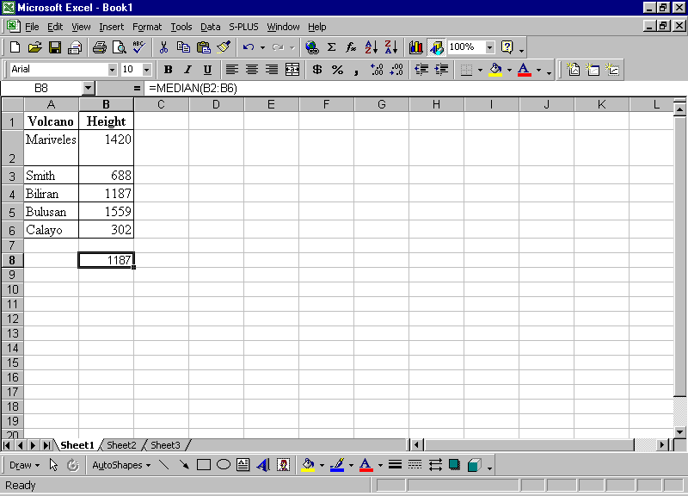
1.1. Mean: Using MS Excel
= AVERAGE(B2:B6)
= 1031.2

Slide 10
1.1. Mean
Basic Features of the Sample Mean
Easy to calculate
Gives equal weights to each observation
Easily distorted by extreme values e.g. data on income

Slide 11
1.2. Median
Given list of data x₁, x₂, …, x_{n}, sorted from smallest to largest (or vice versa)
If the size n of the data is odd, then the median is x_{(n+1)/2}
If size is even, the median is the average of the two middle scores, i.e (x_{n/2} + x_{(n+2)/2} )/2

Slide 12
1.2. Median: Example with Excel
= MEDIAN(B2:B6)
= 1187

Slide 13
1.2. Median
Basic Features of the Sample Median
Easy to compute
Ignores all data values except the middlemost value
Less sensitive to extreme observations

Slide 14
1.3. Mode
Data set can be unimodal, bimodal or multimodal (or it can have no mode)

Slide 15
1.3. Mode: Example
Number of Hours spent watching TV:
3,4,5,1,4,4,3,3,4
Mode = 4

Slide 16
1.3. Mode
Basic Features of the Sample Mode
Useful for categorical or nominal data
Easy to compute

Slide 17
1.4. Other Measures of Centrality
Weighted Mean
where W_{i} is the weight of observation X_{i}
Geometric Mean
Midrange = (max{X_{i}}+min{X_{i}})/2

Slide 18
1.4. Other Measures: Example
Suppose that the numbers {2,5,9} are given such that the number 2 and 9 appear 25% of the time, while the number 5 appears 50% of the time.
Weighted Mean =
= 5.25
While = 5.33

Slide 19
1.4. Other Measures: Example
GM = (2 x 5 x 9)^{1/3} = 4.48
Midrange = = 5.50
Of the three measures of centrality, the mean and the weighted mean appear to be in agreement.

Slide 20
1.5. Measures of Location
Describes the data distribution, i.e. how data are “distributed” on the real line
Quartiles – values that separate sorted data into four equal groups
Percentiles – separate the sorted data into 100 equal groups
1st quartile (Q1) – 25% of data are below it
Q2 = the median
Q3 (upper quartile) – point such that 75% of the observations are below it

Slide 21
1.5. Location Measures: Example
25 data points representing difference in scores of two players:
-47, -38, -15, -3, -47, 28, -1, 16, -22, -25, 37, -48, 38, -7, -28, -47, 26, 20, -8, 40, 34, -24, 48, -28,

Slide 22
1.5. Location Measures: Example
Sorted Data:
-48 -47 -47 -47 -38 -28 -28 -25
-24 -22 -15 -8 -7 -3 -1 10 16 20 26 28 34 37 38 40 48
Q1= –28 (the 25% of 25 = 6.25th observation or the 7th)
Q2 (median) = –7
Q3 = 26 (the 75% of 25 = 18.75th or 19th observation); and the midline as (-28+26)/2 = -1.

Slide 23
1.5. Location Measures: W/ Excel
Sorting data with “sort” icon

Slide 24
1.5. Location Measures: W/ Excel
Q1 = QUARTILE(A2:A26,1)
Q2 = QUARTILE(A2:A26,2) ,
Q3 = QUARTILE(A2:A26,3)
enter these commands in any two unoccupied cells

Slide 25
Measures of Variation
Range
Inter-quartile Range
Five-Number Summary
Mean Absolute Deviation
Variance and Standard Deviation
Coefficient of Variation (CV)

Slide 26
2.1. Range
difference between the largest and smallest values
Range = max{X_{i}} – min{X_{i}}
easy to compute, but hardly used for statistical analysis
extremely sensitive to unusually large or small values

Slide 27
2.2. Inter-quartile Range
difference between the upper and lower quartiles
Inter-quartile Range = Q3-Q1

Slide 28
2.3. Five-Number Summary
consists of the smallest value, the lower quartile, the median, the upper quartile and the largest value
Example: From the previous data set
Range= 48-(-48) = 96
Inter-quartile range = 28-(-78) = 54
Min Value = -48
Max Value = 48
Median = -7

Slide 29
2.4. Mean Absolute Deviation
deviation from the average
= entry - average
average of these deviations is always 0
average of absolute values of these deviations = mean absolute deviation (MAD)
useful for measuring spread
MAD =

Slide 30
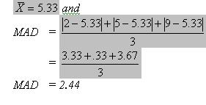
2.4. MAD: Example
Using the number {2,5,9} we obtain

Slide 31
2.5. Variance & SD
Variance – mean of the squared deviations from the average
Standard deviation (SD) – square root of the variance

Slide 32
2.5. Variance & SD
Chebychev’s Inequality indicates that for all data sets
at least three fourths of the data are within two standard deviations from the mean
at least eight ninths of the data are within three standard deviations from the mean.

Slide 33
2.5. Variance & SD: Example
Sample Data | Deviations from the Average | Squared Deviations
-47 | -48 | 2304
28 | 27 | 729
37 | 36 | 1296
-47 | -48 | 2304
34 | 33 | 1089

Slide 34
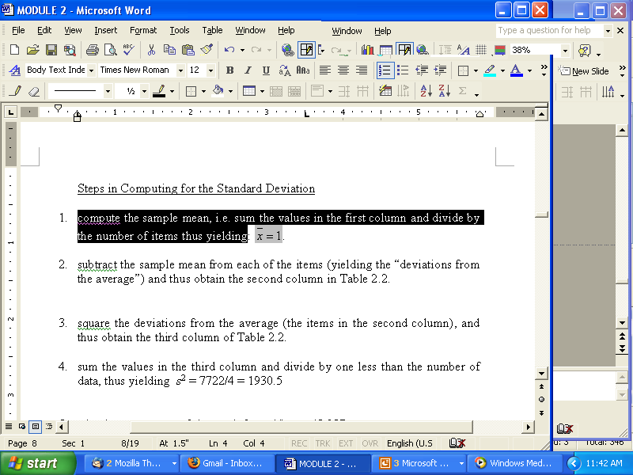
2.5. Variance & SD: Example
To compute for standard deviation
compute the sample mean, i.e. sum the values in the first column and divide by the number of items thus yielding
subtract the sample mean from each of the items (yielding the “deviations from the average”): (2nd column in the table)
square the deviations from the average (2nd column): (3rd column in the table)

Slide 35
2.5. Variance & SD: Example
To compute for standard deviation
sum the values in the third column and divide by one less than the number of data, thus yielding s² = 7722/4 = 1930.5
take the square root of the result from (4):
s = 43.937

Slide 36
2.5. Variance & SD in Excel
standard deviation = STDEV(A2:A6)
= s = 43.397
According to Chebychev’s Inequality, we may expect at least ¾ of the data to be within the interval from 1-2(43.397) = -86.87 up to 1+2(43.397) = 88.87. The Chebychev bound may be quite conservative. In fact, here, all the data are within this interval

Slide 37
2.6. Coefficient of Variation (CV)
the ratio of the standard deviation to the mean, expressed in percent.

Slide 38
2.6. CV: Example
Province | Data | Mean | SD | CV
A | 392, 103, 450, 1040, 201, 501, 294,385, 672, 216 | 425.4 | 271.42 | 0.64
B | 1264, 1041, 2889, 719, 14021, 10793, 823, 570, 602, 573 | 3329.5 | 4892.84 | 1.47
C | 1124, 578, 489, 3913, 1452, 2059, 632, 1668, 848, 416 | 1317.9 | 1064.64 | 0.81

Slide 39
Tables and Graphs
Box-Plots
Frequency Table
Histograms
Stem-and-Leaf Display
Pie Chart

Slide 40
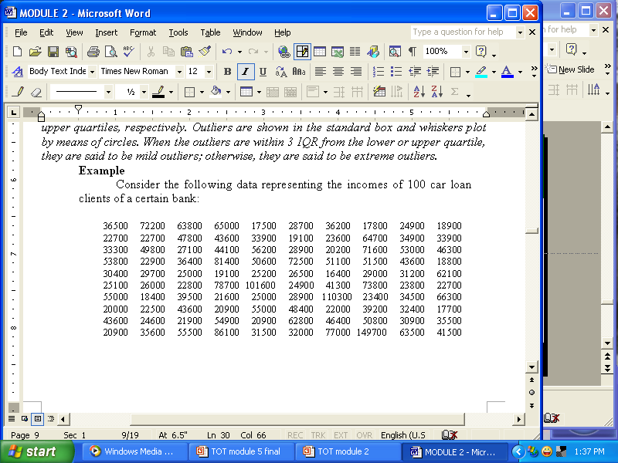
3.1. Box-Plots
incorporates the concepts of the five-number summary
Example: income of 100 car loan clients

Slide 41
3.1. Box-Plots: Example (cont’d)
Q1 = 23750; Q3 = 51880
inter-quartile range = 51880-23750 = 28130
cutoff points for to determine outliers:
23750-1.5*28130 = -18445
51880+1.5*28130 = 94075

Slide 42
3.1. Box-Plots: Example (cont’d)

Slide 43
3.2. Frequency Table
specifies class intervals and respective frequencies of data falling into the intervals
To determine no. of class intervals (k)
Sturges’ rule:
k = smallest integer ≤ to 1+log(n)/log(2)
≈ 1+3.332log(n)
where n = no. of data
Example: n = 100; then k = 7

Slide 44
3.2. Frequency Table: Example
frequency table for incomes
Income Interval | Frequency
Above 0 up to and including 25,000 | 31
Above 25,000 up to and including 50,000 | 40
Above 50,000 up to and including 75,000 | 22
Above 75,000 up to and including 100,000 | 4
Above 100,000 up to and including 125,000 | 2
Above 125,000 up to and including 150,000 | 1

Slide 45
3.2. Frequency Table: Example
cumulative frequency table for incomes
Income Interval | Cumulative Frequency
Above 0 up to and including 25,000 | 31
Above 25,000 up to and including 50,000 | 71
Above 50,000 up to and including 75,000 | 93
Above 75,000 up to and including 100,000 | 97
Above 100,000 up to and including 125,000 | 99
Above 125,000 up to and including 150,000 | 100

Slide 46
3.2. Frequency Table: Example
another frequency table for incomes
table construction involves arbitrary decisions
Income Interval | Frequency
Below 25,000 | 31
From 25,000 up but less than 50,000 | 40
From 50,000 up but less than 75,000 | 22
From 75,000 up But less than 100,000 | 4
100,000 and above | 3

Slide 47
3.3. Histogram
From the first frequency table, we get the following histogram
Income Distribution

Slide 48
3.3. Histogram
Distributions of incomes (as in the histogram) and prices tend to be skewed to the right due to presence of a few high figures.
Data pertaining to scores in an examination tend to be symmetric (and in fact, are typically modeled by a bell-shaped curve).

Slide 49
3.3. Histogram
Data pertaining to the lifelengths of some semi-conductors are skewed to the left. Such results when a few semi-conductors readily fail, with most of the items having a rather long life.

Slide 50
3.4. Stem-and-Leaf Display (SLD)
Major limitation of frequency distributions is that when the data are grouped into class intervals, the original data are lost.
This limitation is overcome by stem-and-leaf display.

Slide 51
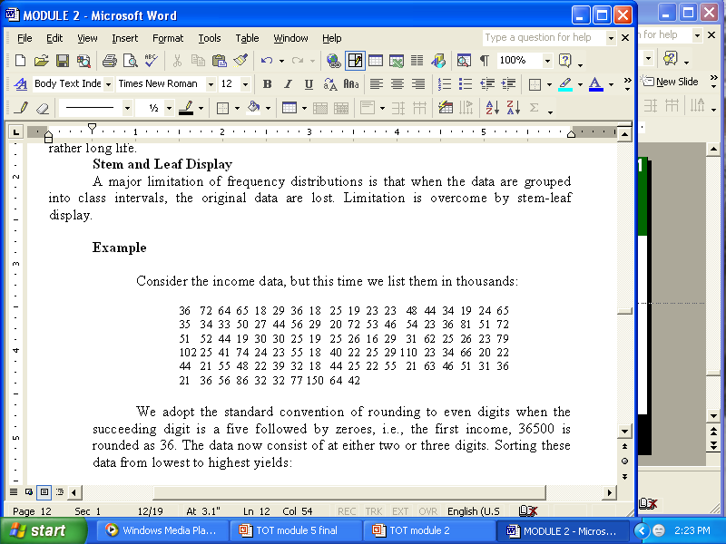
3.4. SLD: Example
Income data, in thousands

Slide 52
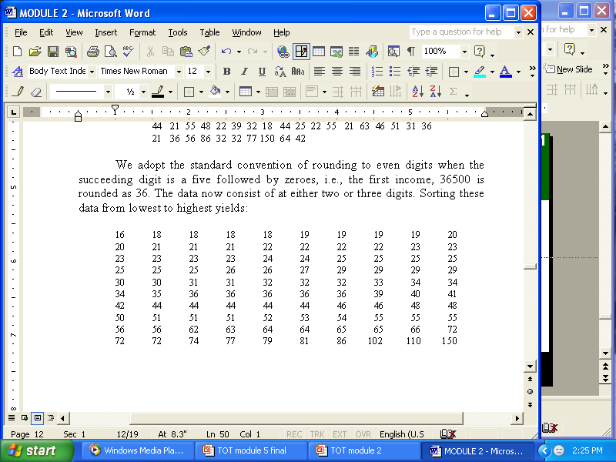
3.4. SLD: Example
Sorting the data,

Slide 53
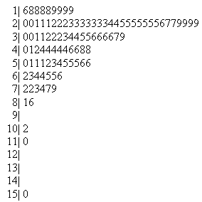
3.4. SLD: Example
Stem-and-Leaf Display of Incomes

Slide 54
3.5. Pie Chart
circle divided into sectors, each sector representing the categories of the data
area of each sector represents relative proportion of data falling in the category
total pie or circle represents 100% of all the data
biggest slice of pie corresponds to the modal category, i.e. category that occurs most frequently

Slide 55
3.5. Pie Chart: Example
Frequency Table
for Number of Dependents of Bank Customers
Number of Dependents | Frequency
0 | 11
1 | 18
2 | 18
3 | 22
4 | 16
5 | 15

Slide 56
3.5. Pie Chart: Example
Pie Chart
Number of Dependents of Bank Customers

Slide 57
WORKSHOP 2
Prepare a group presentation for each of the following:
Infant Mortality Rate (IMR) is a commonly generated measure of the health conditions in an area. The higher the IMR of an area, the less healthy the place is. According to the National Demographic Survey ,conducted in 1995 by the National Statistics Office, IMR in the Visayas and Mindanao regions is generally homogenous.

Slide 58
WORKSHOP 2
Prepare a group presentation for each of the following:
Given the following IMR rates for sample provinces in Visayas and for Mindanao, calculate the sample averages of the IMRs for Visayas and for Mindanao. Compare the health conditions in the two major islands.

Slide 59
WORKSHOP 2
INFANT MORTALITY RATE IN VISAYAS AND MINDANAO PROVINCES: 1995
Region | Province | IMR
Visayas | Aklan | 62.17
 | Antique | 52.40
 | Bohol | 53.93
 | E. Samar | 71.40
 | Iloilo | 50.98
 | N. Samar | 66.60
 | Negros Occ. | 53.98
 | Romblon | 43.8
 | Siquijor | 45.30

Slide 60
WORKSHOP 2
INFANT MORTALITY RATE IN VISAYAS AND MINDANAO PROVINCES: 1995
Region | Province | IMR | Province | IMR
Mindanao | Agusan del Sur | 52.07 | Misamis Occidental | 65.00
 | Basilan | 63.72 | Misamis Oriental | 56.10
 | Bukidnon | 87.20 | S. Cotabato | 52.84
 | Camiguin | 67.10 | Sultan Kudarat | 83.40
 | Davao del Norte | 60.07 | Surigao de Norte | 63.90
 | Davao del Sur | 48.94 | Surigao del Sur | 62.12
 | Davao Oriental | 58.80 | Zamboanga del Norte | 62.31
 | Lanao del Norte | 94.00

Slide 61
WORKSHOP 2
Human Development Index (HDI) is a proxy measure of economic development. It is anchored on the quality of life, largely different from an economic growth perspective as typically measured by gross national product and gross domestic product. The higher the value of HDI in an area, the higher is the quality of life of the people living in this area. Using data from the succeeding table, determine the lower and upper quartiles and the median. Solve also for the midrange and the trimmed mean.

Slide 62
WORKSHOP 2
HUMAN DEVELOPMENT INDEX BY PROVINCE: 1997
PROVINCES | HDI | PROVINCES | HDI
Abra | 0.579 | Cagayan | 0.552
Apayao | 0.529 | Isabela | 0.603
Benguet | 0.624 | Nueva Viscaya | 0.576
Ifugao | 0.448 | Quirino | 0.552
Kalinga | 0.522 | Bataan | 0.723
Mt. Province | 0.541 | Bulacan | 0.700
Ilocos Norte | 0.644 | Nueva Ecija | 0.602
Ilocos Sur | 0.615 | Pampanga | 0.646
La Union | 0.617 | Tarlac | 0.604
Pangasinan | 0.611 | Zambales | 0.598
Batanes | 0.709 | Aurora | 0.585

Slide 63
WORKSHOP 2
HUMAN DEVELOPMENT INDEX BY PROVINCE: 1997
PROVINCES | HDI | PROVINCES | HDI
Batangas | 0.681 | Camarines Norte | 0.549
Cavite | 0.721 | Camarines Sur | 0.568
Laguna | 0.673 | Catanduanes | 0.550
Marinduque | 0.582 | Masbate | 0.487
Occidental Mindoro | 0.553 | Sorsogon | 0.589
Oriental Mindoro | 0.592 | Aklan | 0.553
Palawan | 0.535 | Antique | 0.550
Quezon | 0.599 | Capiz | 0.543
Rizal | 0.690 | Guimaras | 0.555
Romblon | 0.533 | Iloilo | 0.584
Albay | 0.556 | Negros Occidental | 0.539

Slide 64
WORKSHOP 2
HUMAN DEVELOPMENT INDEX BY PROVINCE: 1997
PROVINCES | HDI | PROVINCES | HDI
Bohol | 0.543 | Zamboanga del Norte | 0.505
Cebu | 0.556 | Zamboanga del Sur | 0.521
Negros Oriental | 0.494 | Bukidnon | 0.533
Siquijor | 0.509 | Camiguin | 0.532
Biliran | 0.522 | Misamis Occidental | 0.533
Eastern Samar | 0.509 | Misamis Oriental | 0.540
Leyte | 0.520 | Davao (Norte) | 0.525
Northern Samar | 0.482 | Davao del Sur | 0.517
Samar | 0.492 | Davao Oriental | 0.492
Southern Leyte | 0.550 | Southern Cotabato | 0.532
Basilan | 0.434 | Saranggani | 0.489

Slide 65
WORKSHOP 2
HUMAN DEVELOPMENT INDEX BY PROVINCE: 1997
PROVINCES | HDI | PROVINCES | HDI
Lanao del Norte | 0.465 | Surigao del Sur | 0.516
Cotabato (North) | 0.514 | Lanao del Sur | 0.321
Sultan Kudarat | 0.546 | Maguindanao | 0.403
Agusan del Norte | 0.512 | Sulu | 0.331
Agusan del Sur | 0.478 | Tawi-Tawi | 0.425
Surigao del Norte | 0.526

Slide 66
WORKSHOP 2
Traffic accidents are very prevalent in the metropolis. The Traffic Management Group of the Philippine National Police identified varying causes of accidents. The table below shows that most of the accidents are caused by driving error, that is, people are driving with little knowledge of how top drive properly. Provide a graphical presentation of these data to express the nature of Traffic Accidents in the National Capital Region (NCR).

Slide 67
WORKSHOP 2
TRAFFIC ACCIDENTS BY CAUSE IN NCR: 2000
Causes | Cases | Causes | Cases
Driving Error | 1,116 | Bad Overtaking | 37
Drunk Driving | 110 | Overloading | 331
Mechanical Defect | 339 | Seld-accident | 99
Overspeeding | 115 | Bad Training | 29
Road Defect | 82 | Using Cellphone | 3
Hit and run | 43 | Others | 79
TOTAL | 2,383

Slide 68
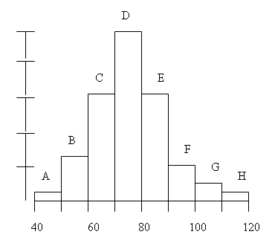
WORKSHOP 2
Three hundred students taking a first course in Statistics are provided a common final examination. This histogram shows the distribution of the final score:

Slide 69
WORKSHOP 2
(cont’d) Answer the following:
Which blocks represent the students who scored between 80 and 100?
About what percentage scored below 60?
About how many students scored between 70 and 90?
Suppose the professor will give 30% weight to the Final Examination, what effect would multiplying 30% on all the Final Scores have on the mean of the Final Exam Scores? on the standard deviation of the Final Exam Scores?
Suppose the professor wants to bloat the Final Examination Scores, what effect would adding 5 points to all the Final Scores have on the mean of the Final Exam Scores? on the standard deviation of the Final Exam Scores?

Slide 70
WORKSHOP 2
The following stem-and-leaf display represent the amount of kilos of rice purchased in a month by a sample of 25 households:
4 | 603
5 | 94133
6 | 652776375
7 | 423972
8 | 13

Slide 71
WORKSHOP 2
(cont’d)
Write the data into an ordered list of numbers.
What amount of rice is most likely to be purchased?
Obtain the mean and standard deviation of the list of purchases.
Is there a concentration of the purchase amounts in the center of the distribution?

Slide 72
WORKSHOP 2
According to the succeeding table, there were 3.1 million unemployed Filipinos in 2000, most of whom were male. Considering the variability of data, find out which between the sexes is more homogenous by solving for the coefficient of variation. Among the three major islands (viz., Luzon, Visayas, and Mindanao), which is the least scattered? (Note: Luzon is composed of Regions 1 to 5, CAR and NCR, Visayas consists of Regions 6,7 and 8 while Mindanao is composed of Regions 9 to 13 and ARMM).

Slide 73
WORKSHOP 2
UNEMPLOYED PERSONS BY SEX & REGION: 2000 (in thousands)
Region | Male | Female
Philippines | 1978 | 1156
NCR | 498 | 267
CAR | 25 | 15
1 | 97 | 50
2 | 35 | 27
3 | 186 | 115
4 | 349 | 173
5 | 95 | 63
6 | 136 | 93

Slide 74
WORKSHOP 2
UNEMPLOYED PERSONS BY SEX & REGION: 2000 (in thousands)
Region | Male | Female
7 | 159 | 78
8 | 69 | 48
9 | 45 | 35
10 | 45 | 36
11 | 118 | 73
12 | 58 | 32
13 | 51 | 28
ARMM | 11 | 20

Slide 75
End of Program 1, Module 2

Slide 76
THANK YOU…

